Slide 1
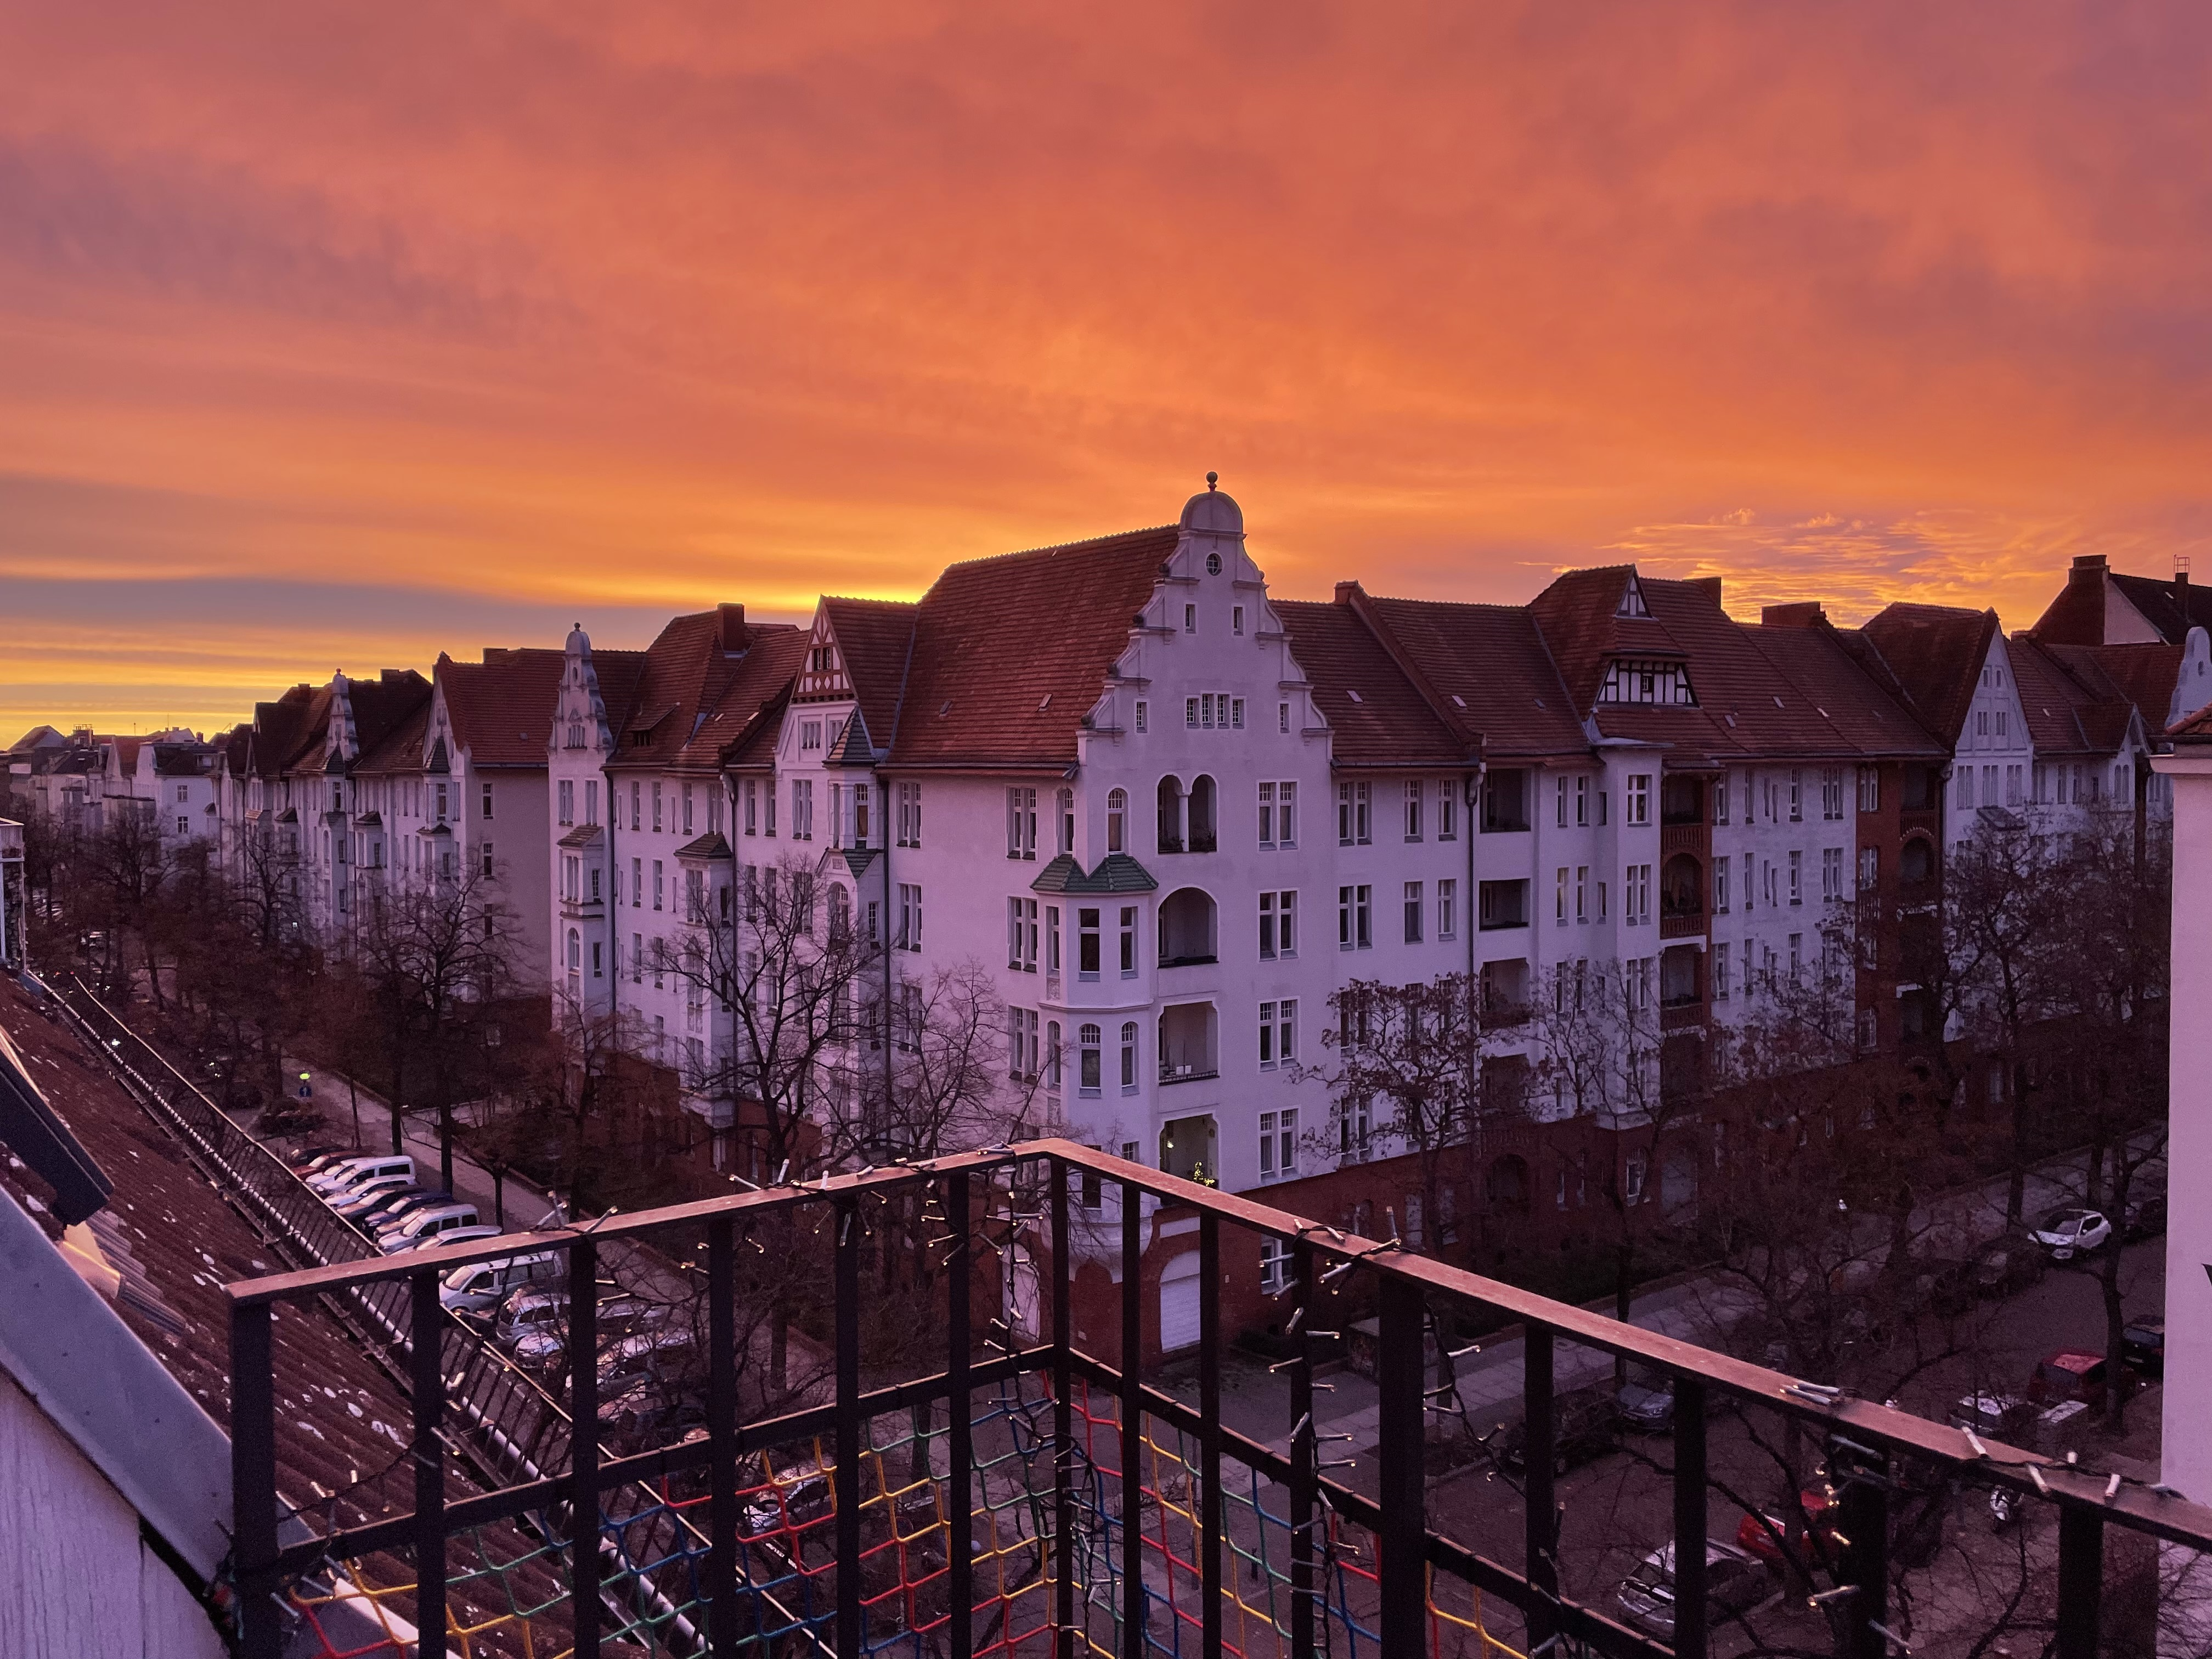
© JeanneDuPre

